Slide 1
Machine Learning Unfolded
Step into the Future with AI/ML

Slide 2
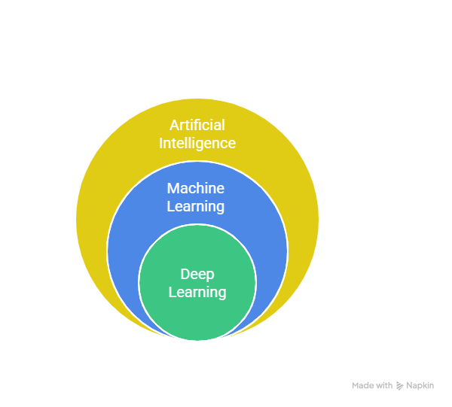
Data Science

Slide 3
AI vs ML vs DL vs Data Science
Artificial Intelligence (AI) : A broader concept the "universe". AI enables an application to perform a task without human intervention.
Machine Learning (ML) : A subset of AI. It provides statistical tools to analyze, visualize, predict, and forecast the data.
Deep Learning (DL) : A subset of ML that uses multilayered neural networks that works on neural network that tries to mimic like human brain.
Data Science (DS) : A field that combines AI ML and DL to create AI-powered applications.
The main goal is to create an AI-powered application.

Slide 4
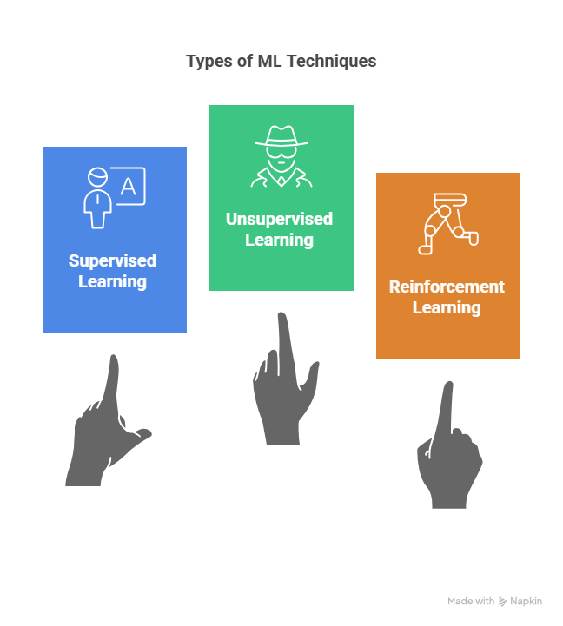

Slide 5
Types of Machine Learning
Supervised Learning : Uses a dataset with both independent (input) and dependent (output) features.
Regression : Predicts a continuous output (e.g., house price).
Classification : Predicts a categorical output (pass/fail, yes/no).
- Binary : Only two output categories (Yes/No)
- Multiclass : More than two output categories(Pass/Fail/May Pass)
Unsupervised Learning : Uses a dataset with only independent (input) features. There is no output/dependent feature.
The goal is to find patterns or create clusters in the data.
Example: Customer segmentation based on salary and spending score.
Reinforcement Learning : A technique that trains software to make decisions to achieve the most optimal results by using Trial-error method.
Example : Robots

Slide 6
Supervised ML Techniques
Regression :
- Linear Regression
- Ridge and Lasso Regression
- Elastic Net
Classification :
- Logistic Regression
Both Classification and Regression :
- AdaBoost
- XGBoost
- Decision Tree
- Random Forest

Slide 7
Unsupervised ML Techniques
K-Means Clustering
Hierarchical Clustering
DB-Scan Clustering
Understanding ML
By using ML we make the computers learn from the data to make some predictions by which we can take any decisions easily.
Example : Predicting whether a mail is SPAM or not.
Predicting student marks based on input features.

Slide 8
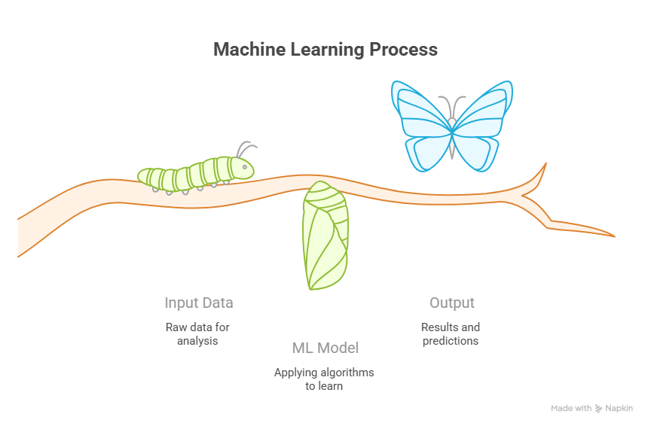

Slide 9
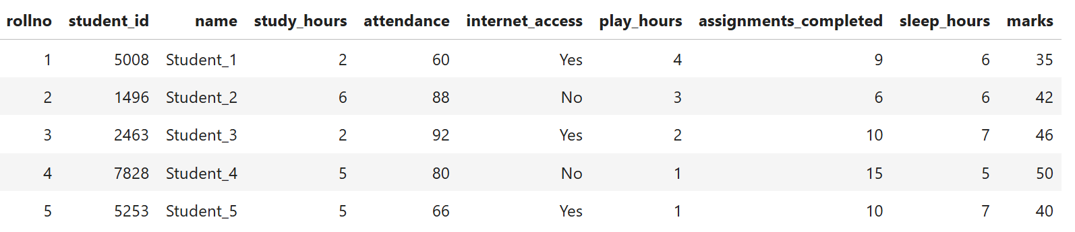
How our Data Looks

Slide 10
CORRELATION
Correlation is a statistical measure used to determine the relationship between two numerical variables / features .
It shows how the input feature is related with output feature.
+1 means Positive Correlation
0 means NO Correlation
-1 means Negative Correlation
Main goal is to understand how much dependent is our Output Feature with respect to Input Features.

Slide 11


How correlated is our I/P with O/P
Output Feature
Input Features
roll no
student id
name
study hours
attendance
internet access
play hours
sleep hours
marks

Slide 12
Feature Selection
Feature Selection is a process in which we keep only important features (highly correlated) and remove unnecessary features.
It helps in training our model efficiently and removes noise from our data.
Unecessary columns
rollno , student_id and name have very less/No correlation with our output feature marks so we are dropping these features.

Slide 13
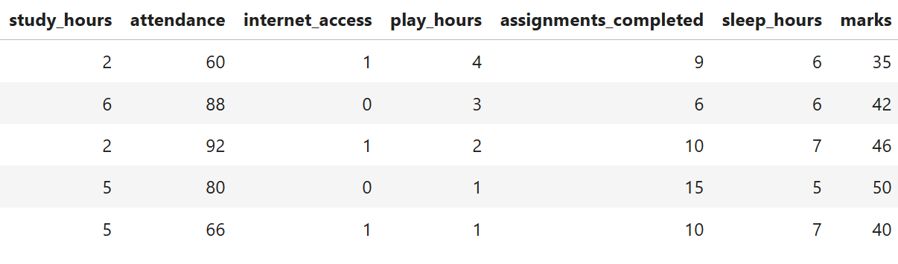
Final Data For Training
Dividing data into input and output features
Input Features
(X)
Output Feature
(y)

Slide 14
Training Data
Training Data is useful for training our model.
Test Data
Test Data is used to test the performance of our model , to check how good our model is trained on the training data , that helps in finding the accuracy of our model.
No. of rows in our dataset : 1000
Training dataset : 800 (80%)
Test dataset : 200 (20%)

Slide 15
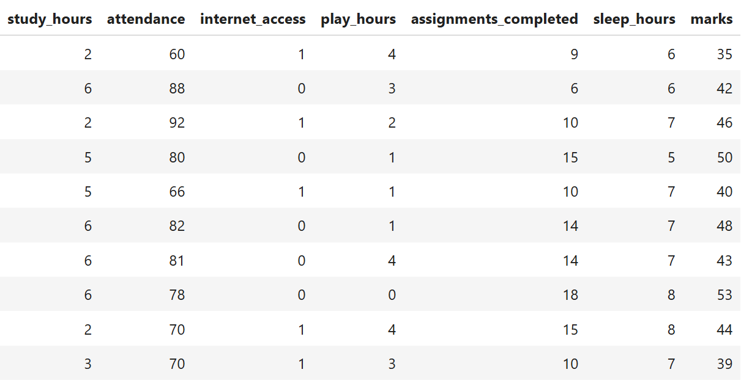
Dividing training and test data
Training
Data
80%
Test
Data
20%

Slide 16
Input training data
Output training data
X_train
y_train
Training
Data
80%
Test
Data
20%
X_test
y_test
Input test data
Output test data

Slide 17
Standardization
Standardization is a technique that is applied to input features to move our data points towards center so that our model can be trained with ease and improves the accuracy of our model.
Before Standardization
After Standardization
.
.
.
.
Scattered
Zero-centered
.
.
.
.
.
.
.
.
.
.
.
.
.
.
.
.
.
.
.
.
.
.
.
.
.
.
.
.
.
.
.
.
.
.
.
.

Slide 18
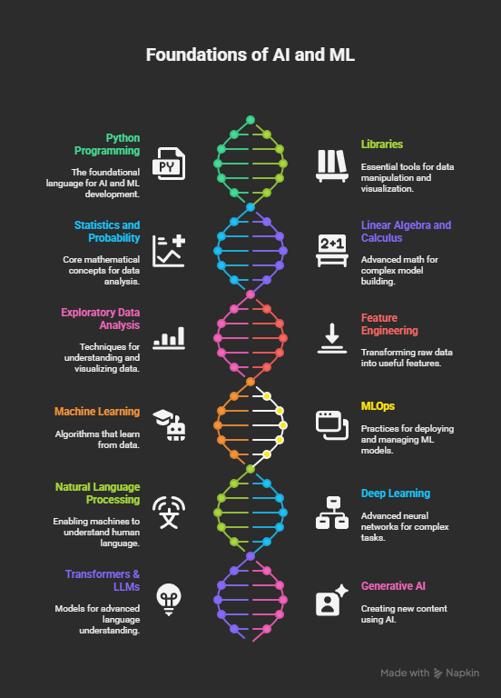
AI & ML
ROADMAP

Slide 19
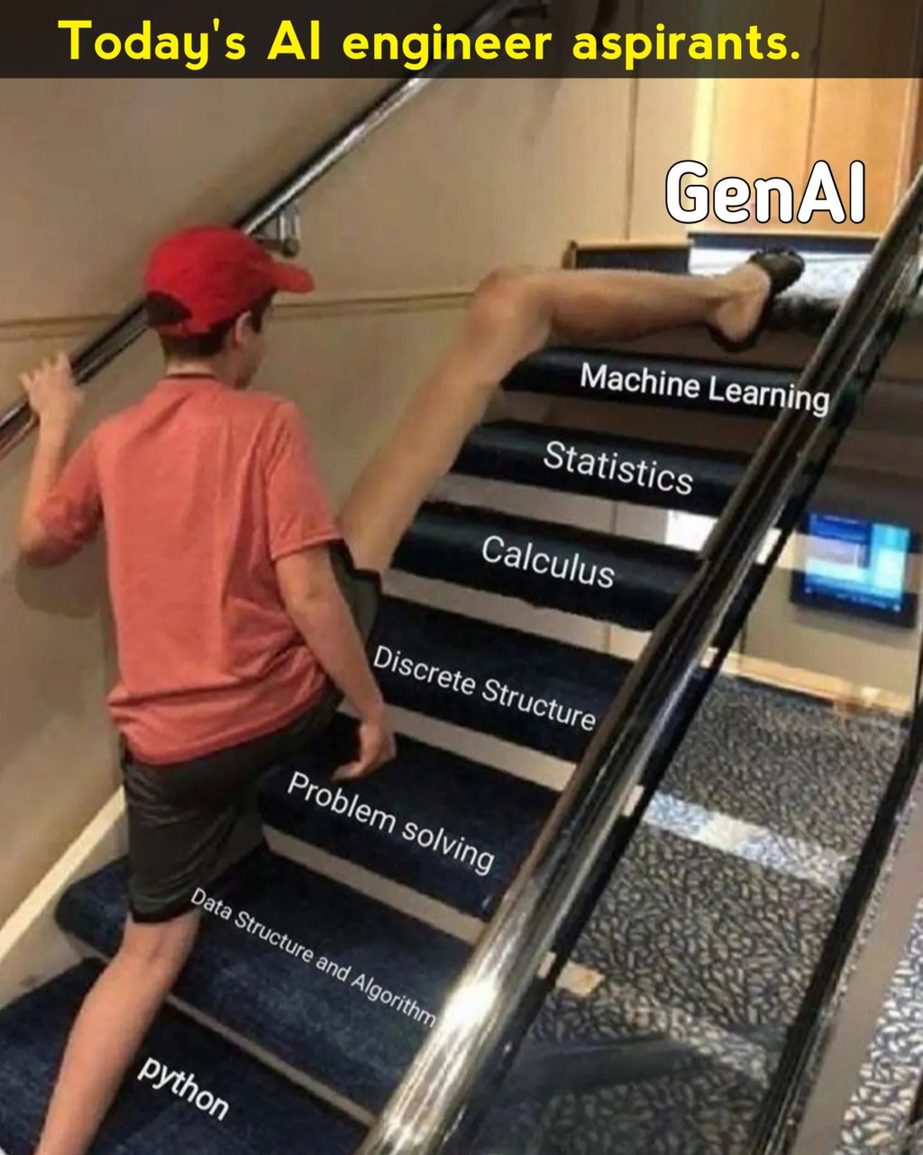

Slide 20
Thank You
AI ML is the new Future

